Slide 1
Adverbs
Level 2
Notes:
http://www.wavsource.com/ ←tons of wav files

Slide 2
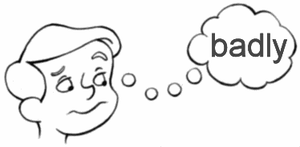
What Is An Adverb?
An ADVERB is a word that modifies (modificacion de verbo) a verb. It tells how, when, where, and to what extent.
If I don’t pay attention to these notes, my grade will fare…
Notes:
http://myword.info/sendword.php?adverb_1

Slide 3

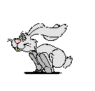
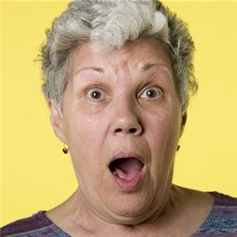
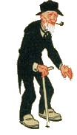
When to Use Adverbs
Adverbs that tell how end with the letters –ly.
Some examples are:
            Fearfully
            Quickly
            Carefully
            Slowly
Swiftly
Kindly
Completely
Perfectly
Notes:
http://madsenworld.dk/anigif/animals.htm ←contains a lot of animated animal .gif files
http://www.amazing-animations.com/ ←tons of animated .gif files

Slide 4

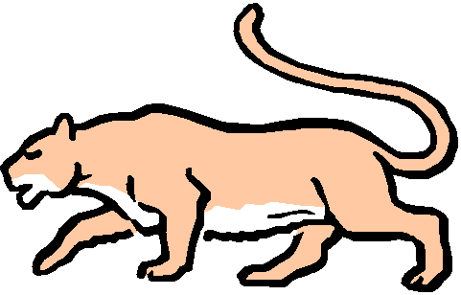

We Can Also Use Them To Compare!
Some adverbs compare two or more actions.
Add –er to compare two actions
ex. slow→slower (I am slower than a cougar.)
Add –est to compare three or more actions
ex. slow→slowest(A turtle is the slowest animal.)

Slide 5
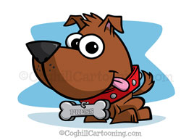
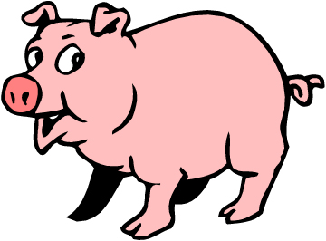

Remember…
If the adverb ends in –ly, use the words more, most, less, or least when comparing
ex. The pig runs more slowly than a dog.
ex. I am the least likely person to become famous.

Slide 6
Got It???
Try THIS!
Notes:
http://myword.info/sendword.php?adverb_1

